Slide 1
Stock Price Forecasting Using LSTM and Gradio
Submitted by: Anshika Thakur (Roll No: CS-2341229)
Supervisor: Ms. Varsha Srivastava
Institution: IILM University, Greater Noida

Slide 2


Overview:
Stock markets are volatile and influenced by multiple factors
Traditional models struggle with non-linear patterns
  Machine learning offers adaptive, data-driven forecasting
Project goal: Build a robust ML system for accurate stock prediction

Slide 3
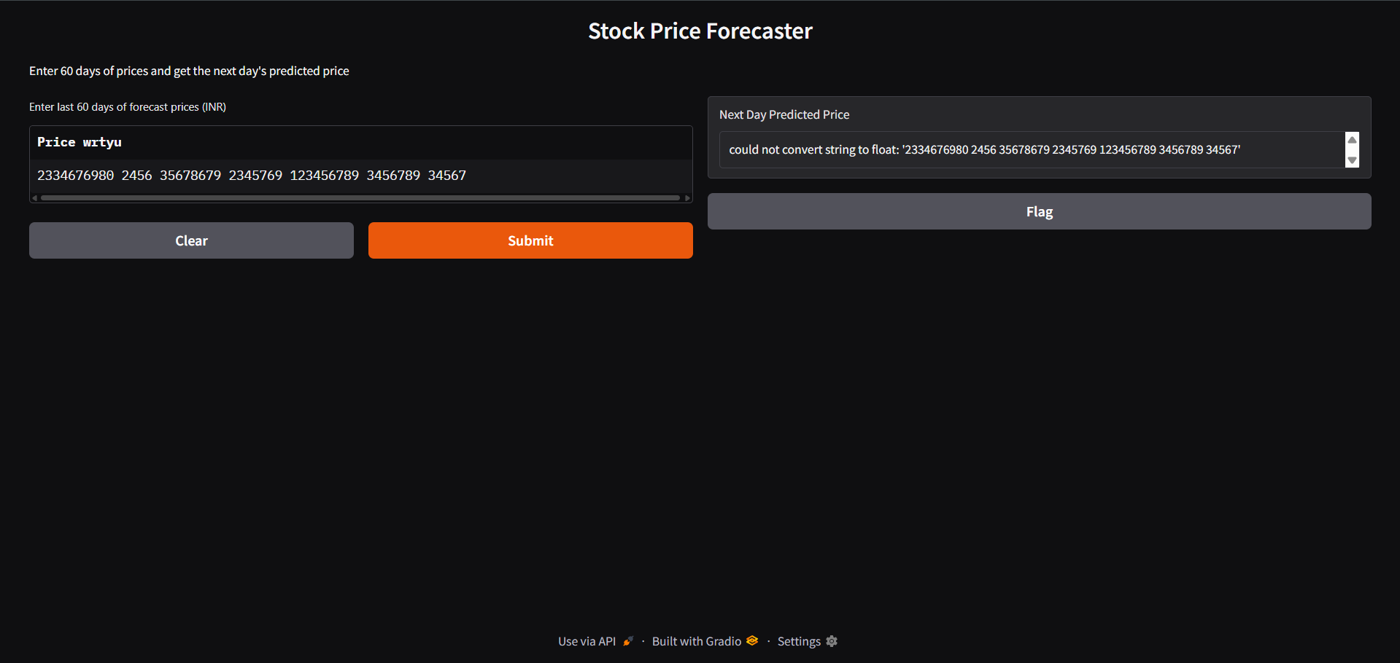
Objectives
Compare ML algorithms: Linear Regression, Random Forest, LSTM
Perform data preprocessing and feature engineering
Improve prediction accuracy through model tuning
Visualize predictions for decision-making
Design a scalable and modular system
Evaluate real-world applicability

Slide 4
Methodology
Architecture Overview:
  Data → Preprocessing → Feature Engineering → Model Training → Prediction
Data Sources:
  Yahoo Finance API, CSV datasets
Software Tools:
  Python, Pandas, NumPy
  Scikit-learn, TensorFlow
  Flask/Django for backend
Technical Indicators:
MA, RSI, MACD, Bollinger Bands

Slide 5
Implementation
Data Collection & Preprocessing:
  Handle missing values, smooth outliers
  Normalize features for model convergence
Model Training:
  Baseline: Linear Regression, Decision Trees
  Advanced: Random Forest, LSTM
Evaluation Metrics:
  MAE, RMSE, R² Score
Visualization:
Interactive dashboards using Gradio

Slide 6
Results and Discussion
Findings:
  LSTM achieved highest accuracy
  Random Forest handled noise well
  Feature engineering improved performance
Visual Insights:
  Predicted vs. actual price plots
Limitations:
  Data sensitivity, interpretability challenges
Scalability:
Modular design supports real-time expansion

Slide 7
Conclusion & Future Scope
Conclusion:
  ML-based forecasting is effective and scalable
  LSTM excels in time series prediction
Future Scope:
Integration with live trading platforms
Use of Transformers for enhanced accuracy
Portfolio-level forecasting and risk analysis

Slide 8


